Slide 1


AI & Robotics
Mentoring for ICSE Class IX & X
Make India
an AI
Super Power
IoT, Robotics
& AI Study
Anodiam, Education that enlightens!
Dependable Competency Partners
Expert Industry Veterans
Lucid & Practical
IT
Competency
Scientific
Knowledge

Slide 2



Anodiam’s Professional Competencies
Anodiam’s mission is to mentor school children into leading edge technologies.
Children’s right appreciation for technology will make India tomorrow’s leader.
Our globally experienced & industry leading coaches are:
Specialists in AI & Robotics Teaching:
Thorough teaching of concepts, hands-on labs & project-based
Support beyond syllabus & instil knack for Comp Vision, NLP etc.
Impart awareness of ethical considerations
Excellent in Teaching Computing Skills
Python language
Perfect for Skill Assessment of Students
Robotics concepts, project-work & lab
AI concepts, project-work & lab
Python programming

Slide 3
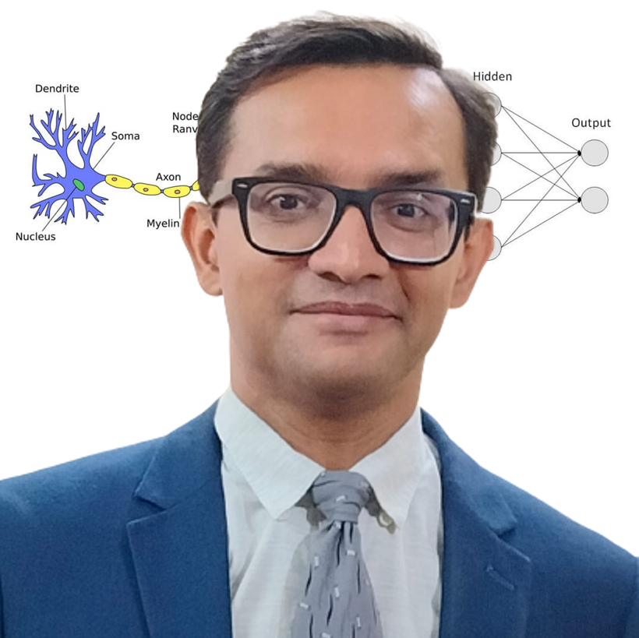
AI & Python Faculty
Empathetic, Dynamic, & Supportive
25 years of blue-chip experience
Corporate trainer & excellent communications
Dynamo of energy, dependable and trusted for the job! – Vish Coosa, Morgan Stanley Bank, U.S.A.
Thorough Knowledge, Can Make Difficult Concepts in AI Seem Lucid
Worked on multiple Corporate AI projects globally
Elementary thinker, visualizes subject matter through clutter & noise
Improved accuracy of AI models singlehandedly up to 99.8%
Super brain, the best guy to take care of AI implementation! – Corporate Client
Anirban Chakrabarty, C.E.O.
B.E.(Electronics), M.B.A. (Finance)
anirban@anodiam.com
+91 9073 700094 / +61 470 142 229

Slide 4
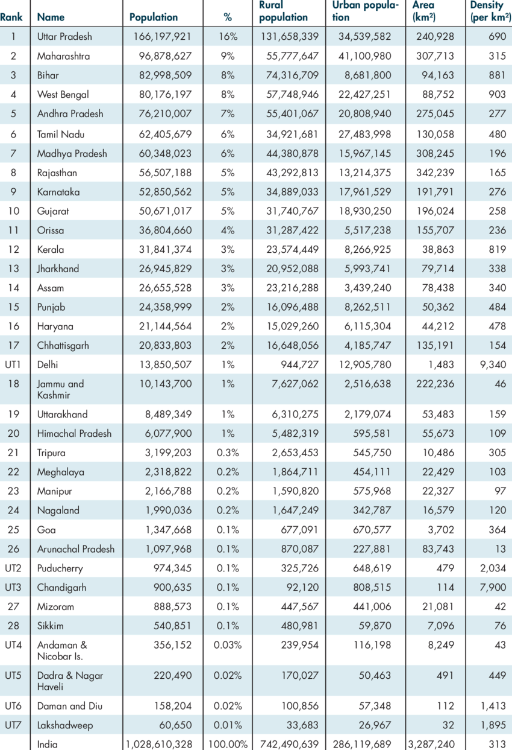
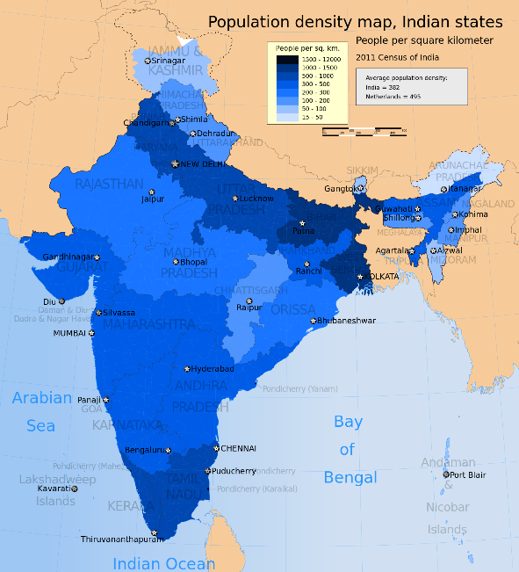

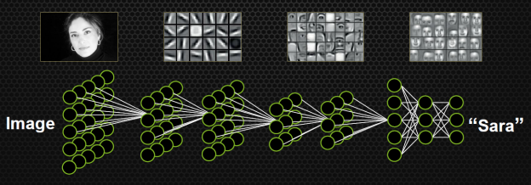
The Anodiam Advantage – Python, Data Science & AI
Visualize the DATA & SCIENCE of data science/AI:
Stimulates interest in otherwise dry subject
Triggers innovation through imagination
Comprehensive training resources
Visualization is key
Relatable & useful, simplified & delightful:
Empathetic & supportive teaching style
Step-by-step, holistic approach
De-clutter the ideas & inspire to seek further
How AI actually works

Slide 5

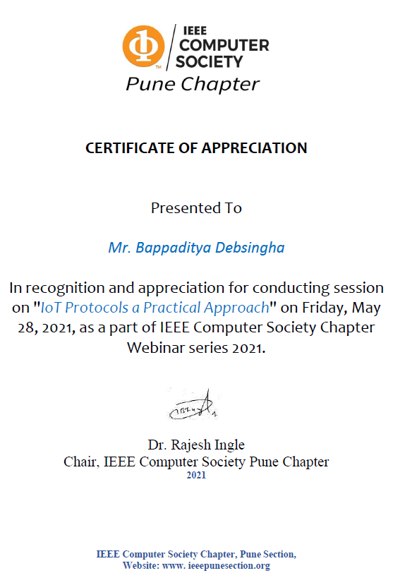
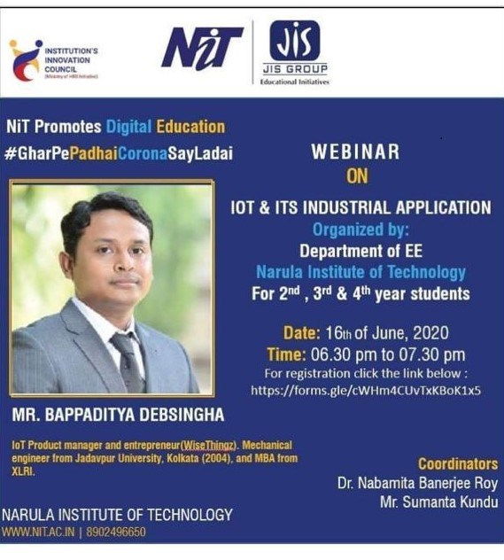
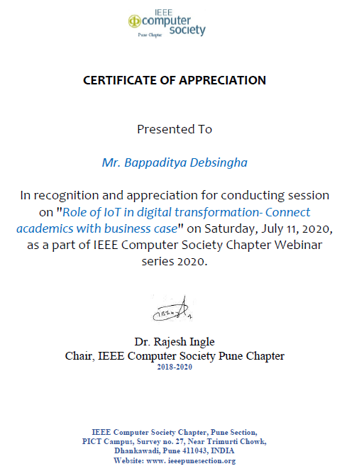
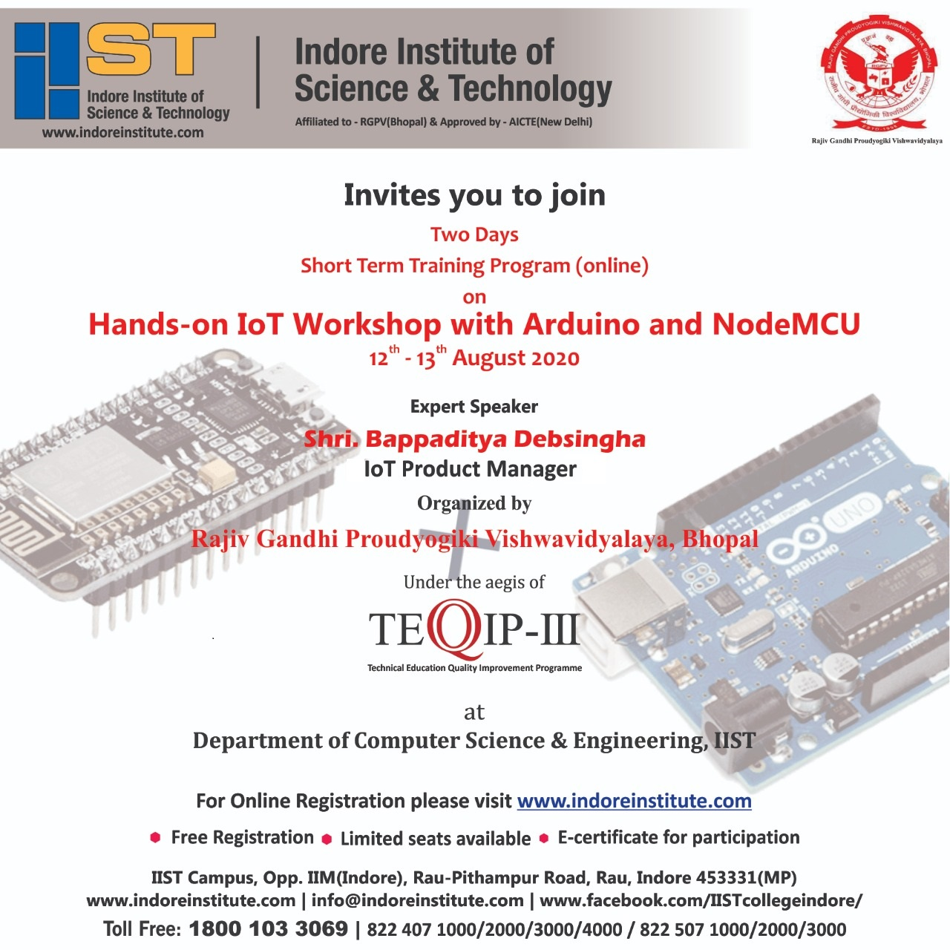
Robotics & IoT Faculty
Inspiring Mentor, Innovative & Entrepreneurial
20 years of global experience
Trained hundreds of children & industry professionals
IoT & Robotics workshops at institutions & corporates
Industry Leading S.M.E. in the fields of
Autonomous machines, automation, sensors & IoT driven BI
Analytics dashboards, Cloud API gateways, integration to mobile apps
Bappaditya Debsingha, IoT Prod Manager
B.E.(J.U., Mechanical), M.B.A.(XLRI)
https://www.youtube.com/c/wisethingz
https://www.instagram.com/bappa_wt
www.wisethingz.com

Slide 6
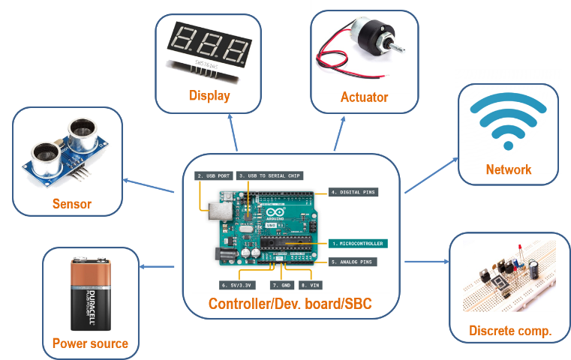
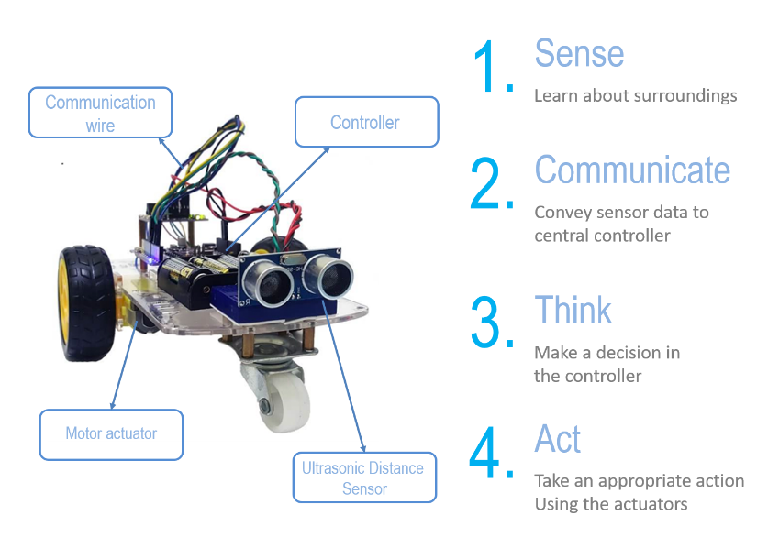
The Anodiam Advantage – Robotics & IOT
At Anodiam, we boast our own:
Development boards
Managed IoT cloud platform
Comprehensive training resources
Robotics Components
We inspire through hands-on projects:
Comprehensive board syllabus coverage
Practical & lucid, help conceptualize
Inspire beyond curriculum to excel career
Experiments & Projects

Slide 7

Pricing
₹5,90,000 (approx. per year per batch - 30 students ICSE, IX/X)
Lab Equipment (provided at actual price)
Less than ₹50,000 (approximately) per year per batch
Robotics & AI including labs
ICSE syllabus comprehensive coverage
₹300 per student per class, 40 classes/year
₹3,60,000 per year per batch of 30 students
Analytics & Python Programming
ICSE syllabus comprehensive coverage
₹150 per student per class, 40 classes/year
₹1,80,000 per year per batch of 30 students
Bulk Discount Available Only for Loreto
33% OFF
per batch after 4th batch

